Slide 1

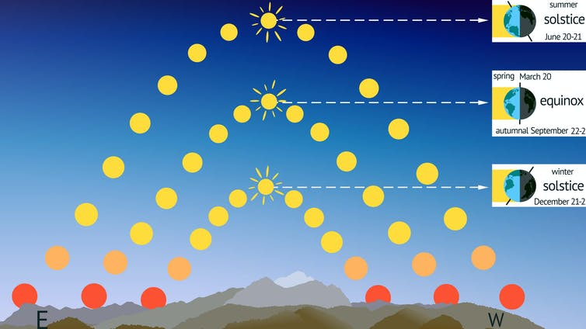
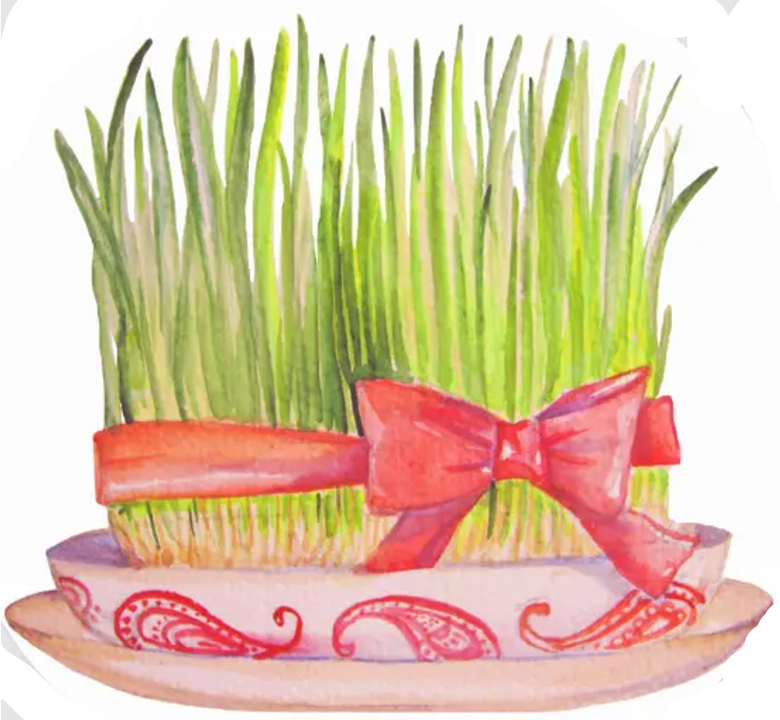
Nowruz [nou’ru:z]
1st Day of the Solar Year
1st Day of Spring
Day of Astronomical Northward Equinox
The moment the sun crosses equator
When night and day are equal
Usually occurs on March 20 or March 21
(depending on location)

Slide 2
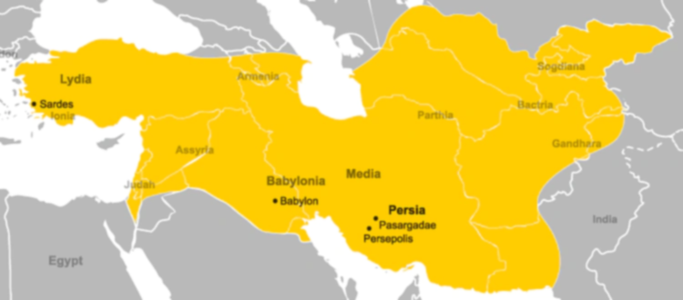
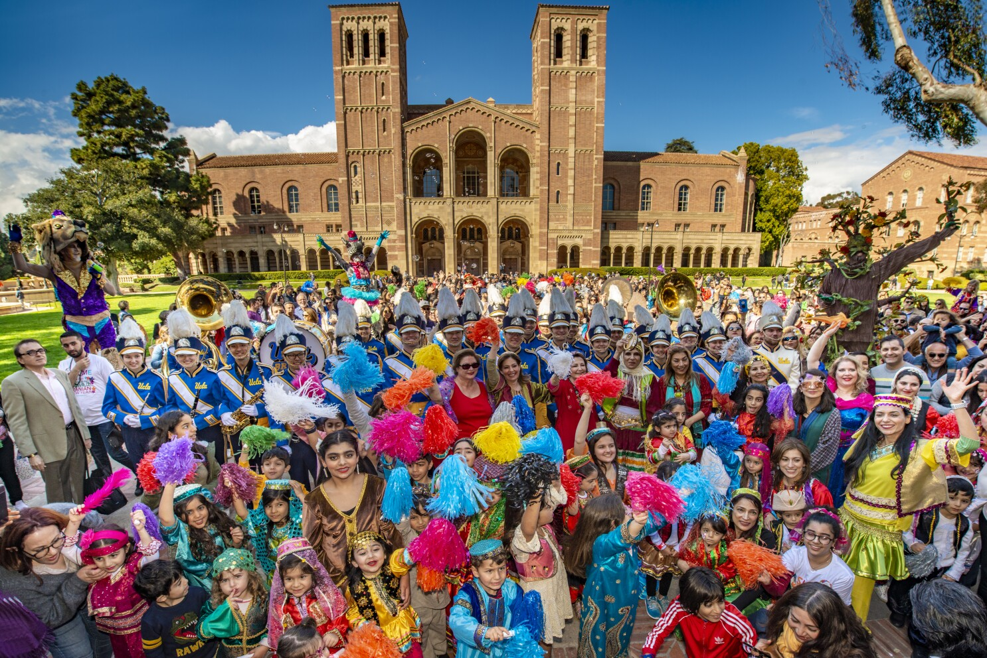
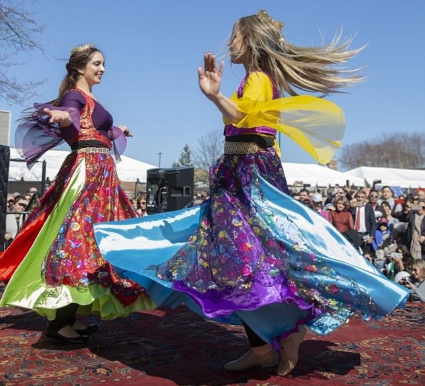
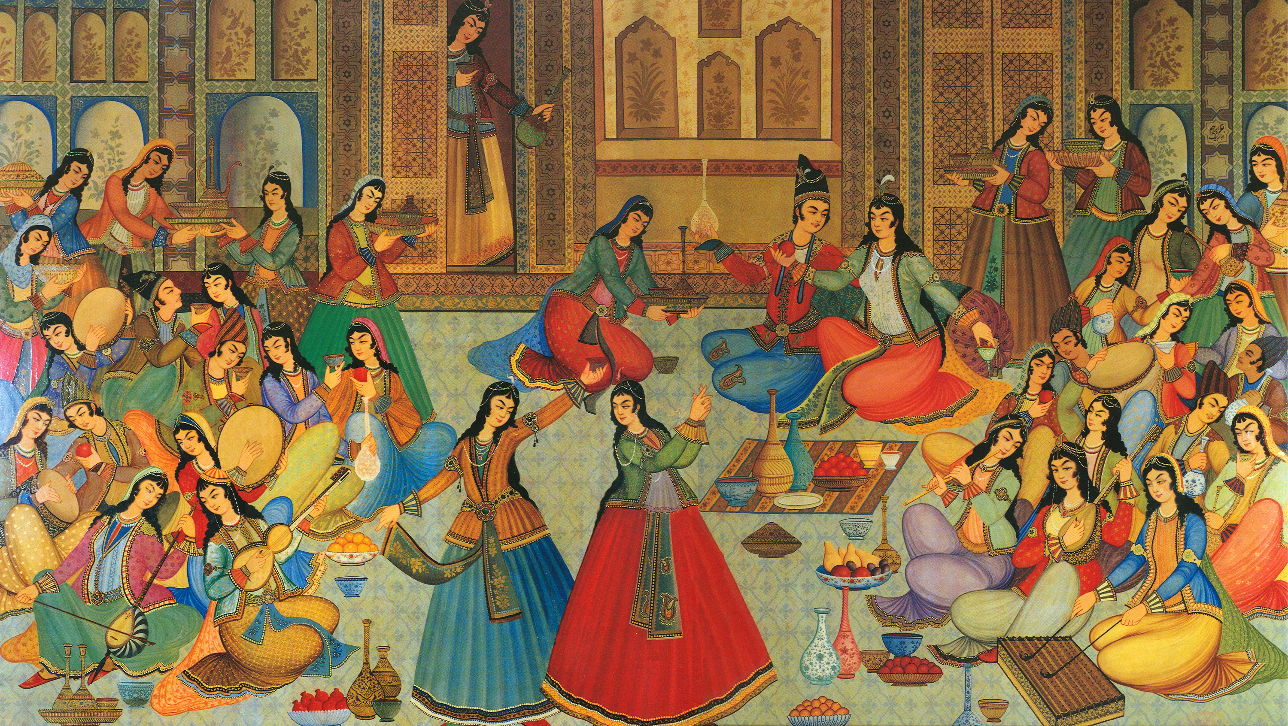
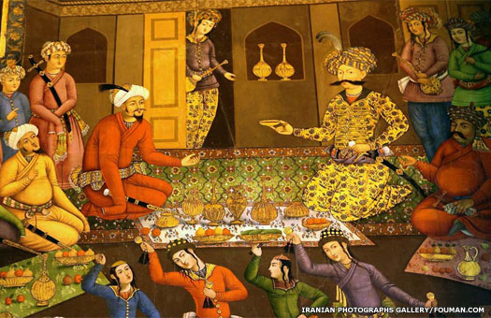
Nowruz
The Origins

Slide 3

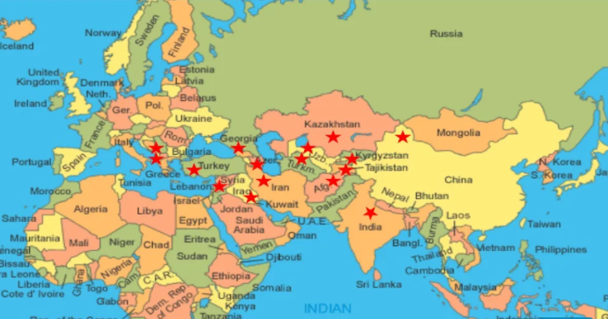
Afghanistan
Albania
Azerbaijan (five days)
Georgia
Iran (thirteen days)
Iraqi Kurdistan
Kazakhstan (four days)
Kosovo
Kyrgyzstan
Bayan-Ölgii, Mongolia
Tajikistan (four days)
Turkmenistan (two days)
Uzbekistan
Nowruz
Countries which Nowruz is a public holiday
Also celebrated by factions in
Armenia
Bangladesh
Central Asia
China
Georgia
India
Pakistan

